Slide 1
FORMAT FOR REFLECTIVE REPORT
HLA YEE YEE

Slide 2
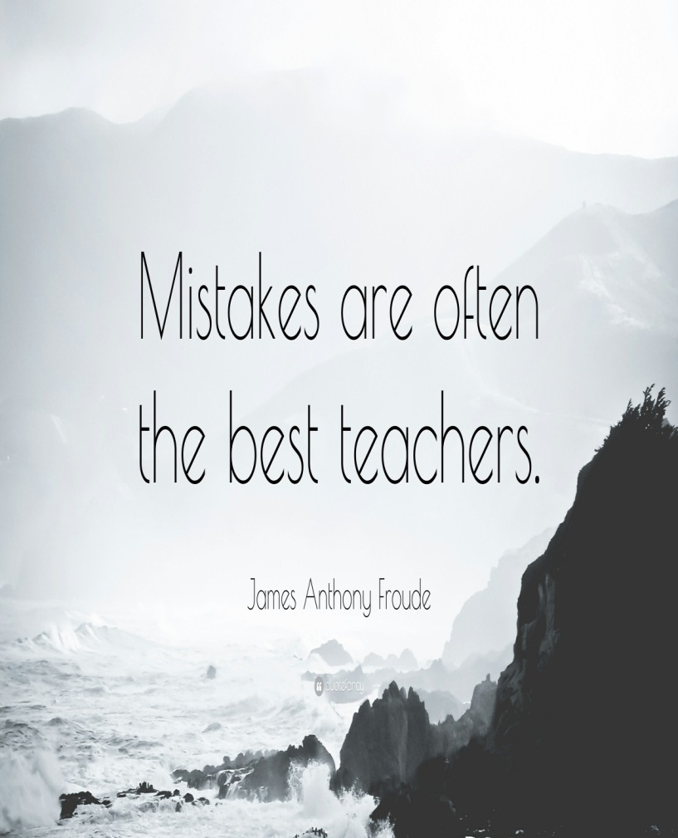
WHY REFLECT?
Learning without reflection is a waste. Reflection without learning is dangerous.
- Confucius
Critical reflection is an evidence - based examination of the sources of and gaps in knowledge and practice with the intent to improve on both- Ash & Clayton, 2009

Slide 3
BENEFITS OF REFLECTIVE PRACTICE
Increased learning from an experience
Promotes deeper learning
Identification of personal and professional strengths and areas for improvement
Identification of areas for improvement
Identification of educational needs
Acquisition of new knowledge and skills

Slide 4
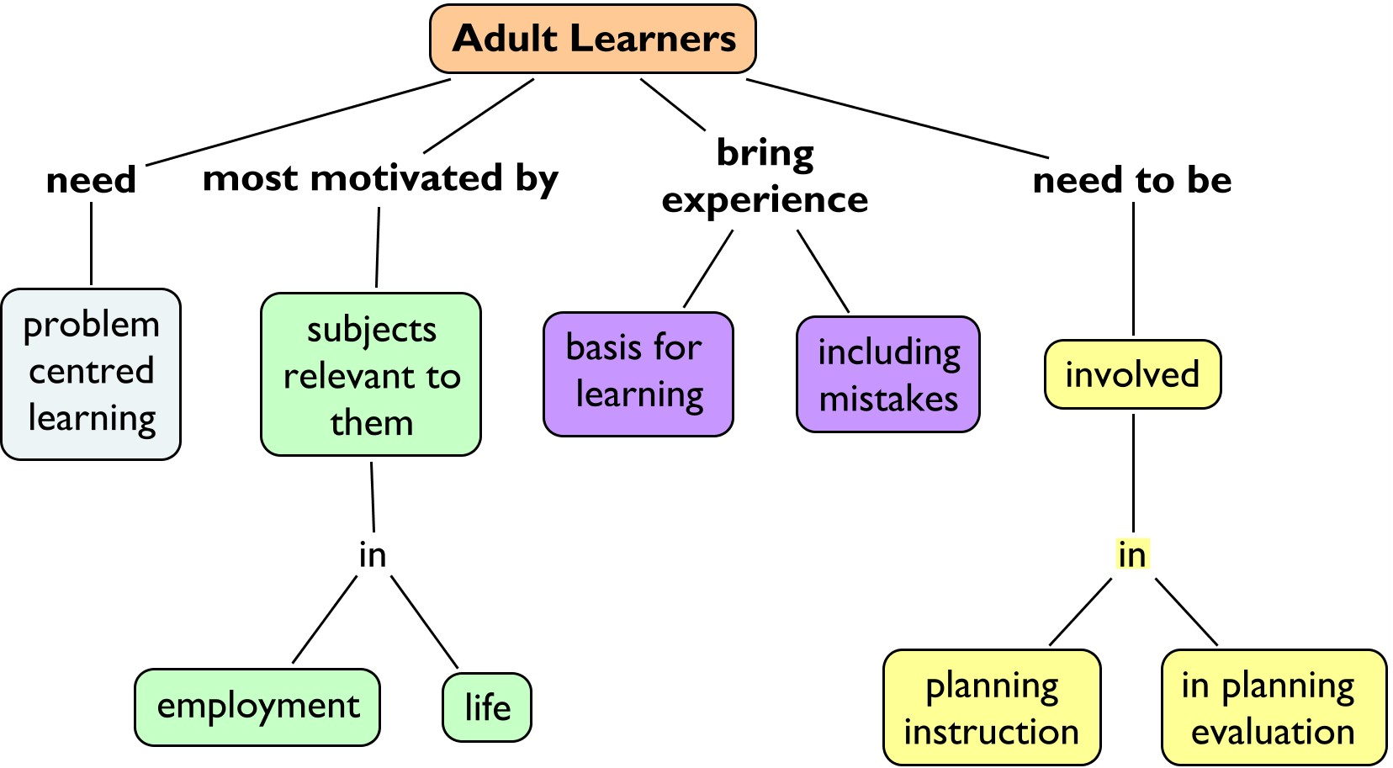
Androgogy
Shared experiences
Reflection
Empowerment/
Individualised
learning

Slide 5
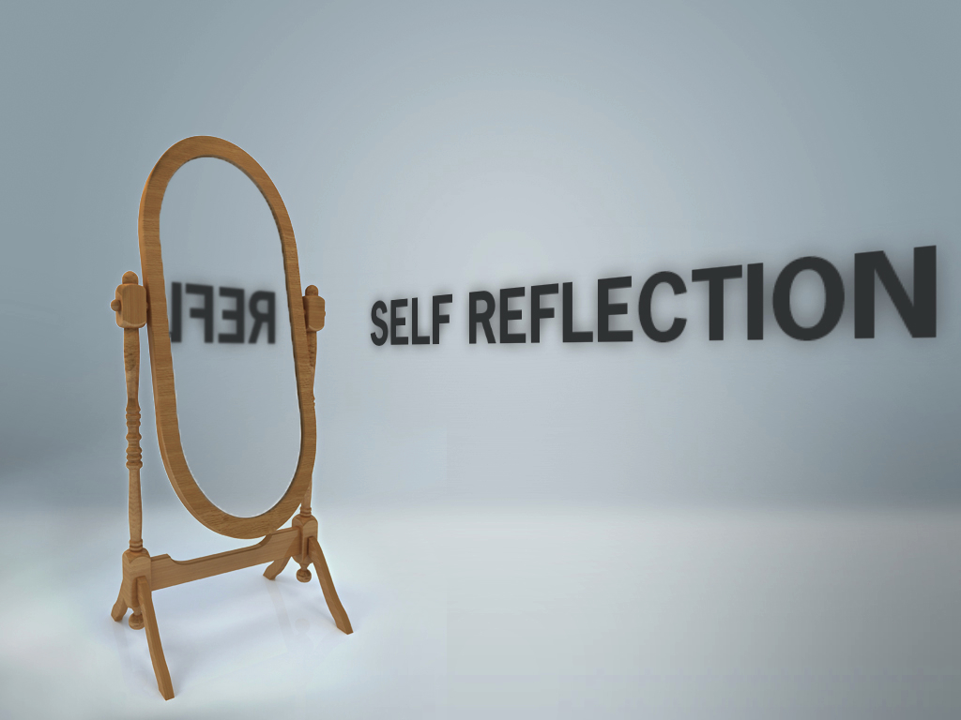

Slide 6
DEAL Model for Critical Reflection
Describe, Examine, and Articulate Learning
LEARNING
Describe
Examine
Articulate
DESCRIBE ( SAME AS GIBBS)
EXAMINE ( FEEL, EVALUATE, ANALYSE in GIBBS MODEL)
ARTICULATE LEARNING (CONCLUDE, PLAN in GIBBS MODEL)
WHAT YOU LEARNT
WHAT WOULD YOU DO TO OVERCOME PROBLEMS ENCOUNTERED ?)

Slide 7
Step 1: Describe
Describe your experience objectively. Answer the following prompts
What did you do?
Where did you do it?
Who were you working with and/or for?
When did this happen?
Why did you do it
What did you say or otherwise communicate?
Who else was there?
What actions did you/ others take?
Who didn’t speak or act?
What else happened that might be important
(equipment failure, weather - related issues, etc )

Slide 8
Step 2: Examine
Examine your experience in terms of the desired learning outcomes:
Values
Ethics
Roles
EXAMINE
FEEL
EVALUATE
ANALYSE
Team-working

Slide 9
Step 3: Articulate
Use your responses to the prompts above in both the “Describe” and “Examine” sections of this reflection template to create a thoughtful essay wherein you articulate what you have learned from your IPE experience.
Each of the following questions should be addressed in your essay
What did I learn?
How did I learn it?
Why does it matter?
What might/should be done in light of it

Slide 10
LANGUAGE
DESCRIPTION OF THE LEARNING EXPERIENCE
Learning objectives
Where was it conducted?
When was it conducted and for how long?
How was it conducted?
Who were your team mates?
2. EVALUATE
2.1. PERSONAL REFLECTION
Your knowledge and skills
The benefits of reflection
Your opinions, views and goals
2.2. ANALYSIS
What was good about the learning experience? Why?
What needs to be improved? Why?
Suggestions for improvement

Slide 11
3. Articulate
3.1. The benefits of reflection
This situation allowed/enabled me to explore my
approach to/ reflect on my…
Reflecting upon the incident, I …
Reflection has provided me with the opportunity to…
I can now appreciate the significance of my experience/
value my past experience
the opportunity to examine/explore… / enhance my practice/ability by…develop/work towards/re-evaluate my goals…
function autonomously/as an individual… /become an active/independent learner…/
plan realistic career/educational/personal goals

Slide 12
Considering the situation from different perspectives
has allowed me to/provided me with…
This provided/equipped me with a new way of
approaching…
I have begun to recognise my strengths as well as my
weaknesses recognise/identify my knowledge and
skills/ build upon my/ enhance my…
I now feel more confident about - integrating new
ideas with present knowledge / presenting my
view/opinion/ articulating my feelings

Slide 13
Reflection Essay Title
(IPE Activity & date )
By: ( Your Name and Student ID )
Student Learning Outcome Area
(The core IPE value addressed for this IPE activity )
Description
What did you do?
Name the activity e.g. visit to the community/ Old Folks’ Home/ Day Care Centre.
What was your role?
Where did you do it?
Name the site of the activity
Who were you working with and/or for?
How many of you? How many Universities? How many students from
each University
When did this happen?
Date (s) of activity
How was it conducted?
Why did you do it
What are the learning outcomes ?( Identified by the IPE Committee)

Slide 14
2. Examine
Feel
How did you feel about the IPE activity? Were you uneasy/ uncomfortable/ all right , working with strangers from different courses ? Did you feel it was worthwhile or a waste of time?
Evaluate
Do you think it was a productive activity? Were the learning outcomes achieved? Are you satisfied with your own performance? How about the performance of your team-mates?
Analyse
What went right? Why?
What was not all right? Why?
How did you react to / resolve these?
How can these be improved?

Slide 15
3. Articulate learning
I learned that ………………………………………………………………………………………………………………………………………………………………………………………………………………………………………………………………………………………………
I learned this when ……………………………………………………………………………………………………………………………………………………………………………………
This learning matters because ……………..........................................
In light of this learning, I shall apply this knowledge to/ avoid repeating the mistake / be more careful when………………………………………

Slide 16
ASSESSMENT

Slide 18
Reflective report by a medical student (University of Liverpool)
14/03/2009 - I observed an operation on a rather obese patient. The Consultant Surgeon was making fun of the patient’s obesity and the whole team was laughing. I hope the patient was really unconscious. It seemed so uncaring and unprofessional. I would never act this way when I graduate. What is the level of this reflection?
15/03/2009- The Consultant made his rounds this morning. His communication with the patient operated on yesterday, and the obvious empathy he showed, made me feel ashamed that I questioned his behaviour yesterday. I realise that operating on obese patients carry an added risk, and the Consultant must have been under enormous pressure. He was trying to ease the tension by cracking jokes. What is the level of this reflection?

Slide 19
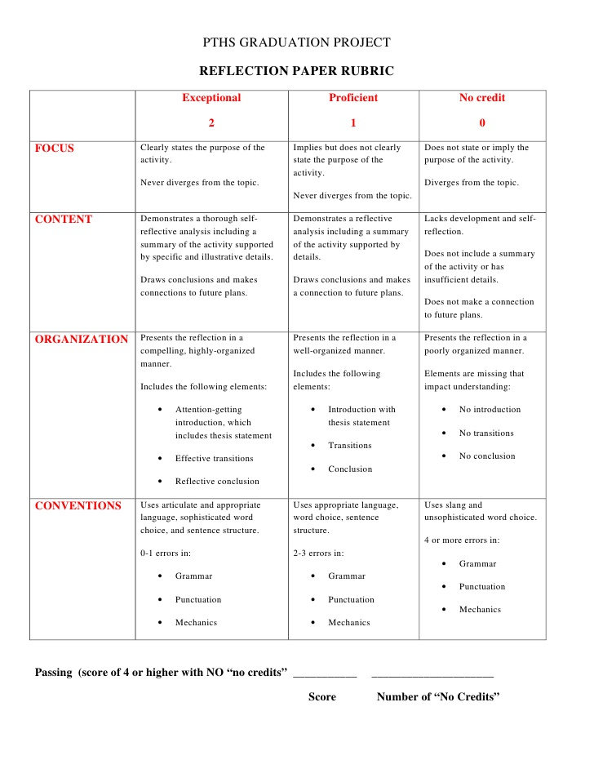

Slide 20
Adapted from: Ash, Clayton, & Moses. (2009). Learning through Critical Reflection: A Tutorial for Service
Learning Students Raleigh, NC. www.usf.edu › engagement › documents › reflection

